Slide 1
Lesson 1: First steps
Year 8 – Intro to Python programming
Notes:
Last updated 16-04-21
Resources are updated regularly — the latest version is available at: ncce.io/tcc.
This resource is licensed under the Open Government Licence, version 3. For more information on this licence, see ncce.io/ogl.

Slide 2
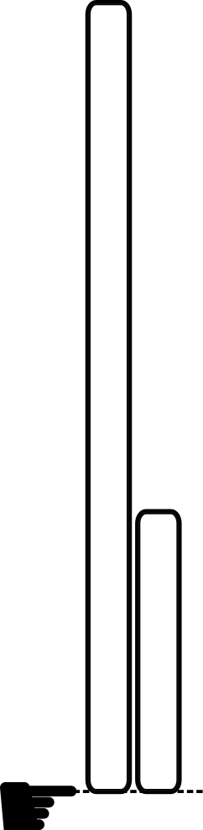

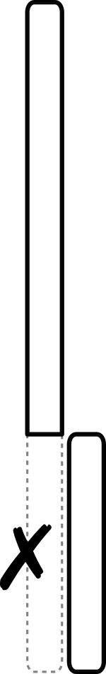
Starter activity
Can you follow these instructions?
You have two strips of paper. One is X cm long, the other is Y cm long.
a
b
c
Align the two strips at one end.
Cut the longer strip where the shorter strip ends.
Discard the part that you have cut off that is the same length as the shorter strip.
Repeat to until the strips are equal in length.
Measure that length and report it — it’s the required result.
a
c

Slide 3
Starter activity
Euclid’s method: finds the LCF of X and Y
❠
Following these instructions solves a problem: it calculates the largest common factor of X and Y.
This is the granddaddy of all algorithms, because it is the oldest non-trivial algorithm that has survived to the present day.
Donald Knuth
The Art of Computer Programming
This algorithm was recorded by Euclid in around 300 BC.
Have you heard of the term ‘algorithm’ before?

Slide 4
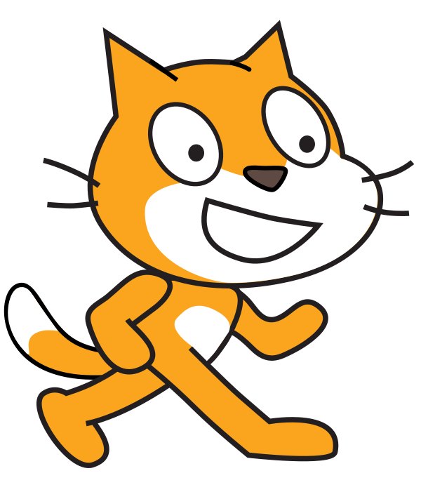
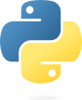
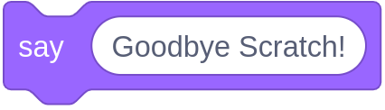
Unit objectives
In the previous units, you...
In this unit, you will...
Used a block-based programming language (Scratch) to create programs that involved:
Variables, operators, and expressions
Sequence, selection, and iteration
Subroutines
Lists
Use a text-based programming language (Python) to build on these concepts and extend them
print("Hello Python!")
Notes:
Image sources:
https://en.wikipedia.org/wiki/Scratch_(programming_language)#/media/File:Scratch_Cat.png
https://www.python.org/community/logos/

Slide 5
Objectives
In this lesson, you will...
Define algorithms and programs and describe how they are executed
Write and execute your first Python programs
They will involve displaying messages, assigning values to variables, and
receiving input from the keyboard.
Battle syntax errors!

Slide 6
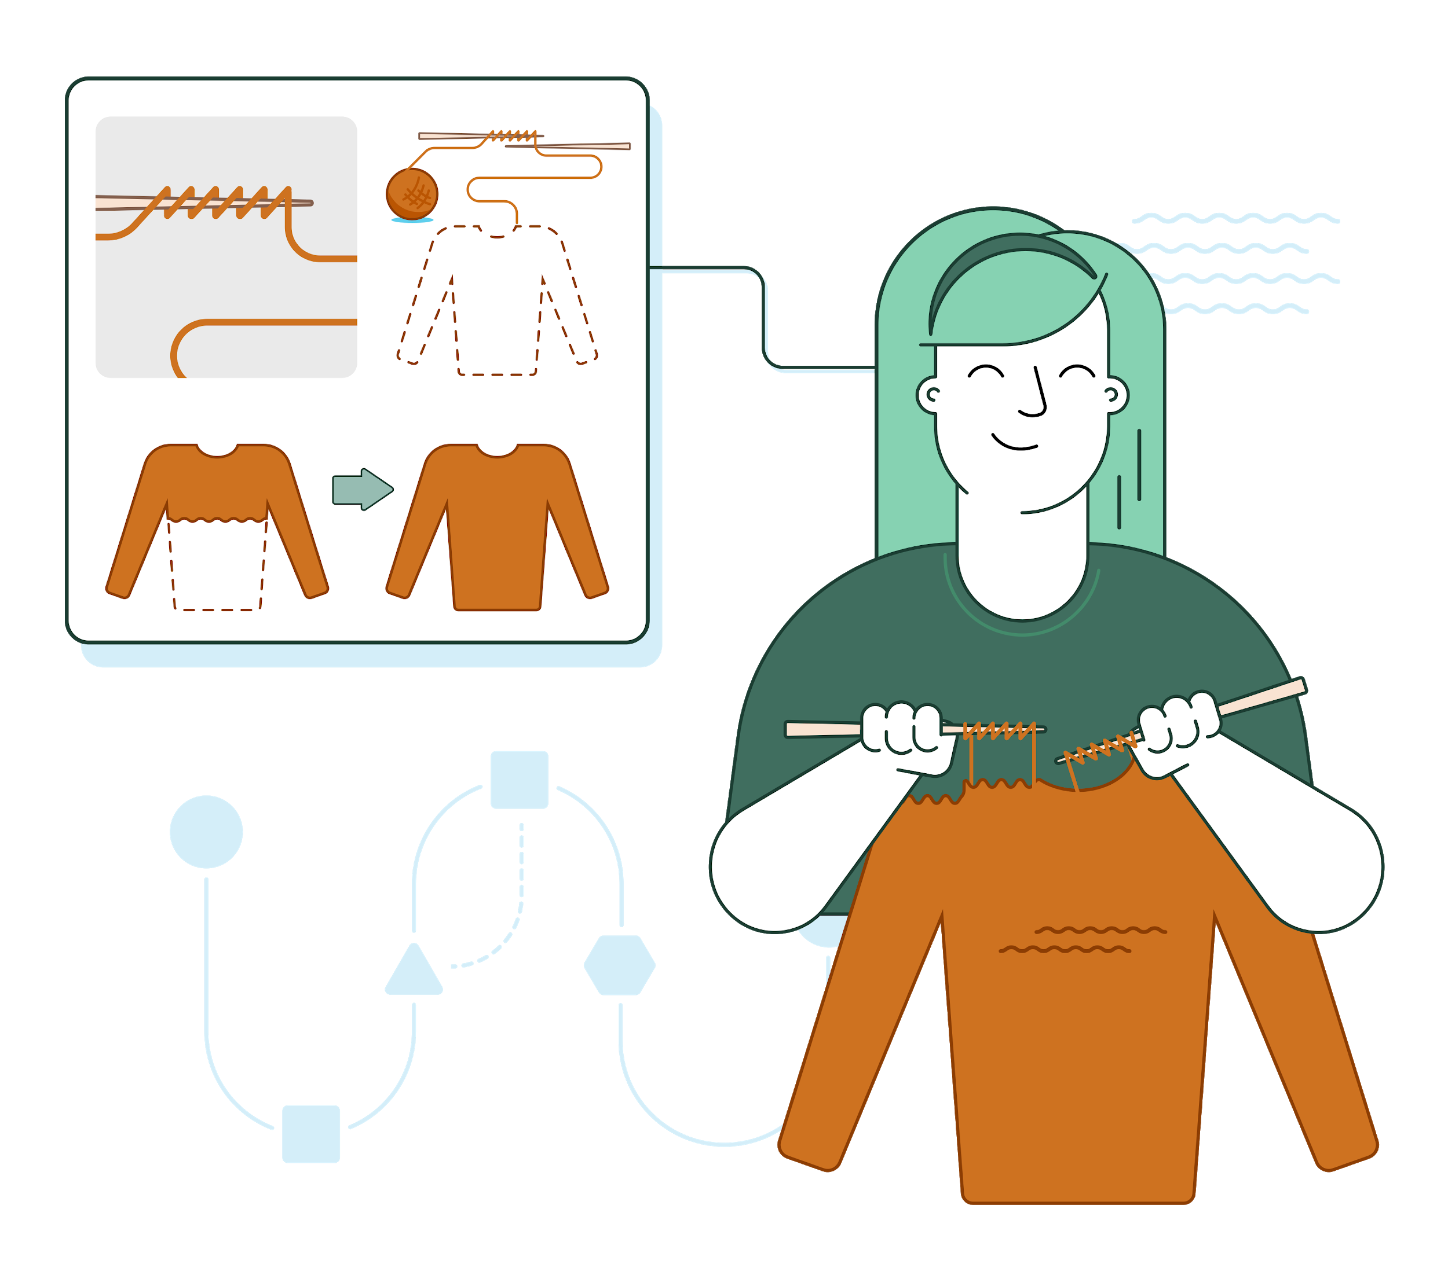
Activity 1
Algorithms
An algorithm is a set of precise instructions, expressed in some sort of language (e.g. textual, visual).
Understanding the language is necessary in order to execute the instructions.
Executing these instructions is meant to solve a problem.

Slide 7
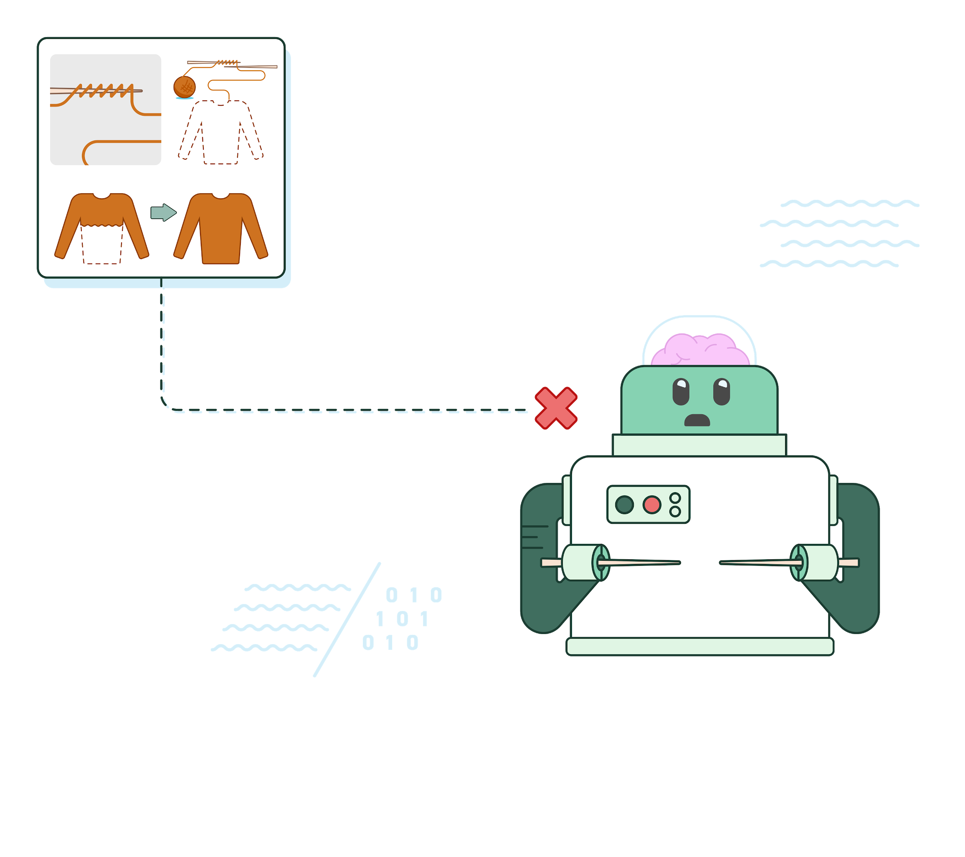
Activity 1
Programs
A program is a set of precise instructions, expressed in a programming language.
Translating the programming language is necessary for a machine to be able to execute the instructions.
Python is a programming language.

Slide 8
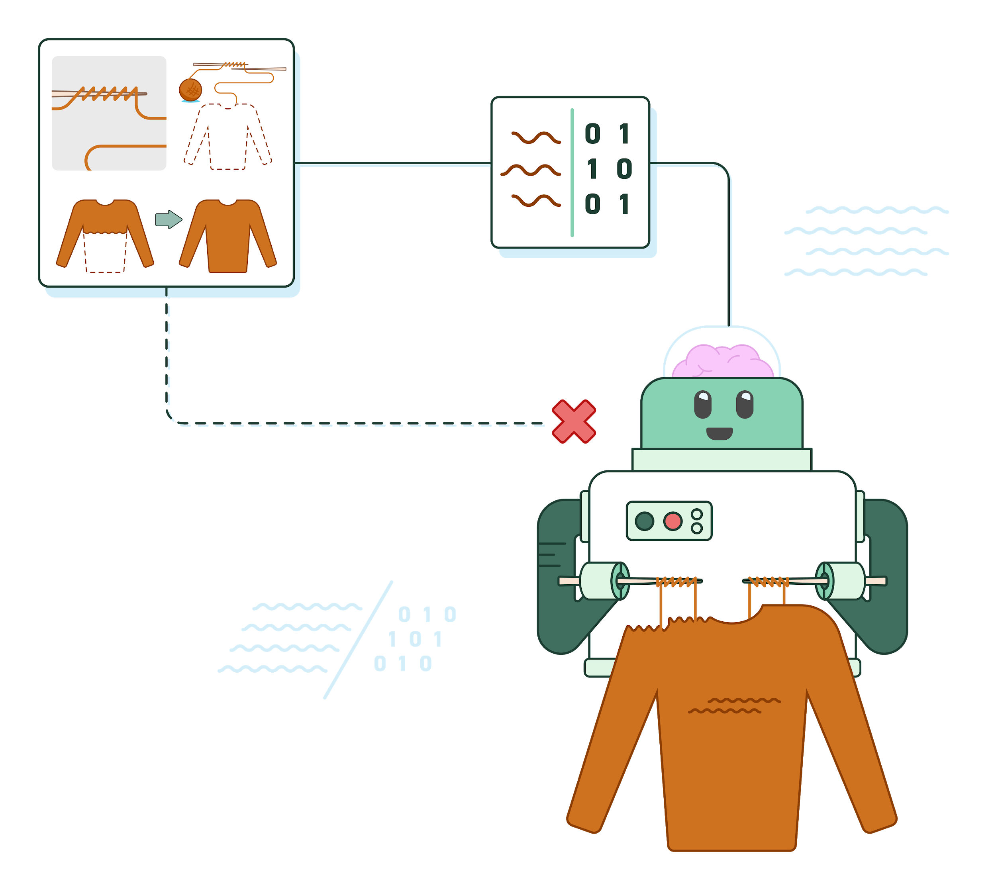
Activity 1
Python programs
To execute a Python program, you need a Python interpreter.
This is a program that translates and executes your Python program.
The Python interpreter doesn’t necessarily run on your computer.

Slide 9
Activity 1
Syntax
All programming languages have rules for syntax, i.e. how statements can be assembled.
All languages have rules for syntax, i.e. how sentences can be assembled.
Programs written in a programming language must follow its syntax.
Speech or text in a language must follow its syntax.
Programs with syntax errors cannot be translated and executed.
Humans can infer meaning even in cases when syntax rules are violated.
For example, “tonigth see you”, instead of “see you tonight”, will probably be understood.
Notes:
Then why do we use text-based programming? Because the things that you can express are infinite, and there are only so many blocks.

Slide 10
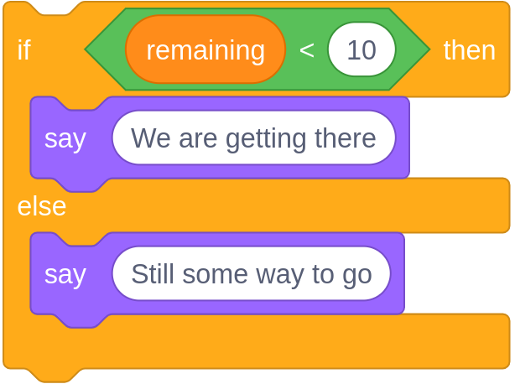
Activity 1
Syntax
All programming languages have rules for syntax, i.e. how statements can be assembled.
Programs written in a programming language must follow its syntax.
In Scratch, syntax errors are not possible: rules are enforced by the blocks and the way they fit together.
Programs with syntax errors cannot be translated and executed.
You can still make logical errors ! That’s when your program doesn’t work the way it should.
Notes:
Then why do we use text-based programming? Because the things that you can express are infinite, and there are only so many blocks.

Slide 11
Activity 1
Syntax
All programming languages have rules for syntax, i.e. how statements can be assembled.
if remaining < 10:
print("We are getting there")
else:
print("Still some way to go")
Programs written in a programming language must follow its syntax.
In Python, you can (and you will) make syntax errors. You will need to follow the syntax rules.
Programs with syntax errors cannot be translated and executed.
Syntax errors can be frustrating when you start learning a text-based programming language.
Notes:
Then why do we use text-based programming? Because the things that you can express are infinite, and there are only so many blocks.
Teachers may be interested in this discussion: https://www.futurelearn.com/courses/block-to-text-based-programming/7/steps/556352

Slide 12

Activity 1
Syntax
SyntaxError: invalid syntax
SyntaxError: Missing parentheses in call to 'print'.
SyntaxError: EOL while scanning string literal
Has this happened to
YOU
Don’t be overwhelmed by these errors. They are here to discourage the faint-hearted. You can fix them!
?
Notes:
Image source: https://commons.wikimedia.org/wiki/Category:Lord_Kitchener_Wants_You#/media/File:KitchenerWants.tif

Slide 13
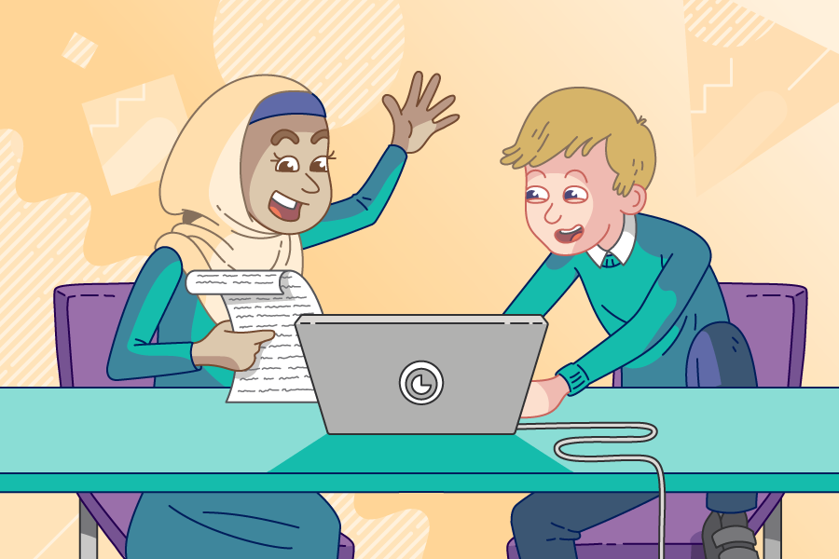
Activity 2
Your first steps in Python
Use pair programming .
Driver
Control the keyboard and mouse.
Navigator
Provide support and instructions.
Alternate between roles.

Slide 14

Activity 2
Your first steps in Python
print("Hello world!")
Every time you learn a new programming language,
it’s a tradition to get your first program to say “hello”.
Live coding

Slide 15
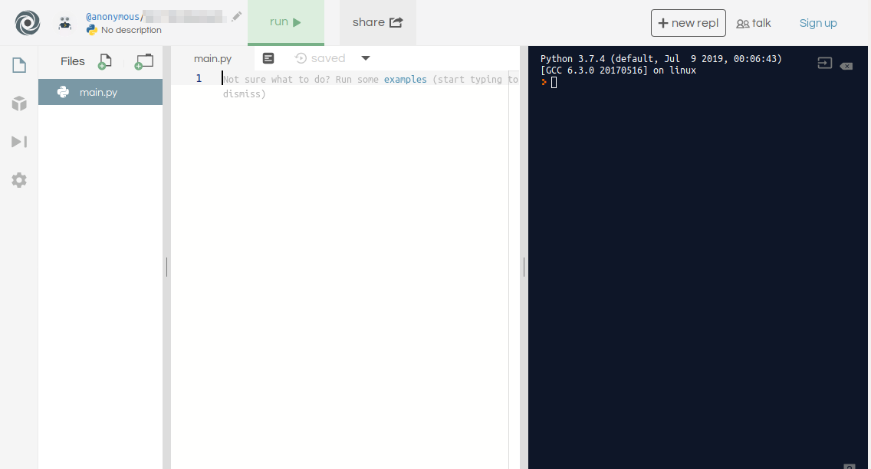
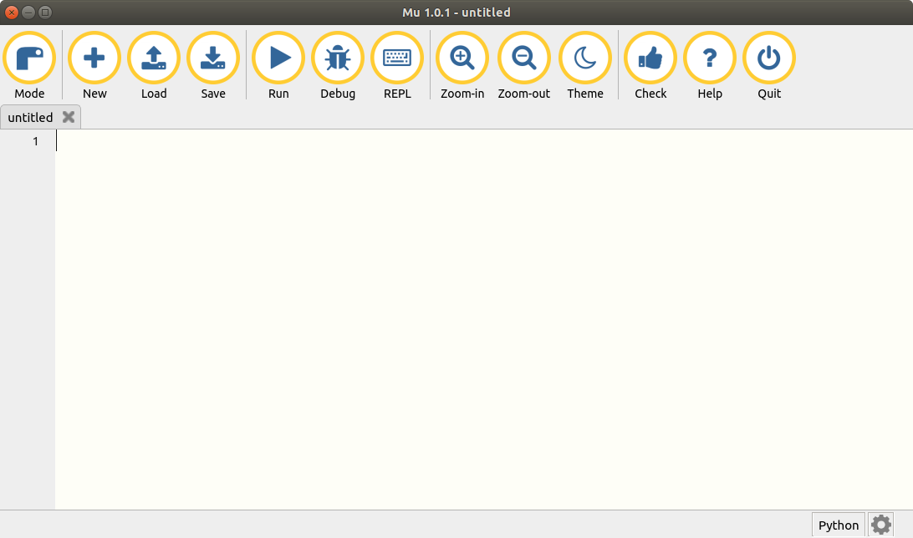
Activity 2
Walk-through of the environment

Slide 16
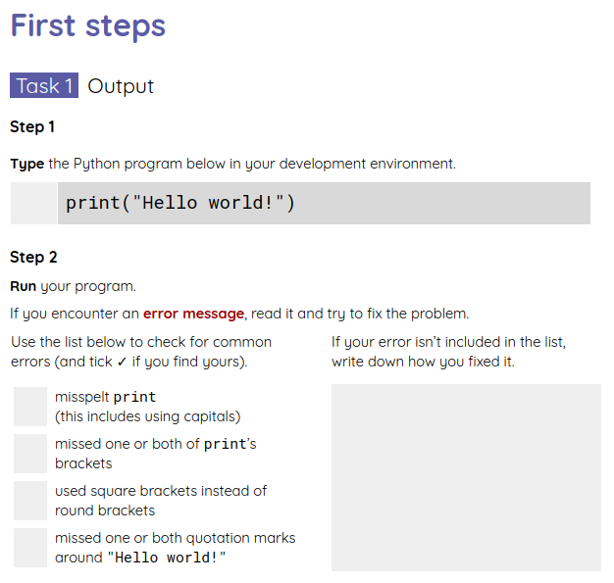
Activity 2
Your first steps in Python
Complete the first task in your worksheet to create your own ‘Hello world’ program.

Slide 17
Activity 2
Your first steps in Python: commentary
print("Hello world!")
Checklist:
Have you spelt print correctly?
Python is case-sensitive: using capitals makes a difference.
✔
Have you used (opening and closing) round brackets around the message to be displayed?
✔
Have you used (single or double) quotation marks around the message to be displayed?
✔

Slide 18
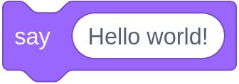
Activity 2
Your first steps in Python: commentary
print("Hello world!")
You will need the print function:
when your program must display text, numbers, or the values of variables and expressions.

Slide 19
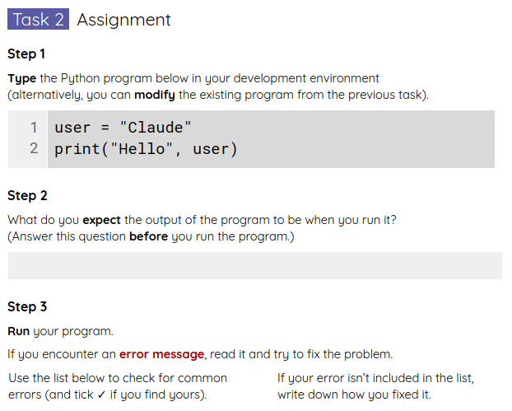
Activity 2
Your first steps in Python
Complete the second task in your worksheet to greet the user by name.

Slide 20
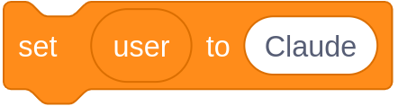
Activity 2
Your first steps in Python: commentary
user = "Claude"
print("Hello", user)
You will need an assignment statement:
when your program must use a name
(an identifier) to keep track of a value.
user is a variable, i.e. a name for a value.
The variable user currently refers to the value "Claude".
The quotation marks around the value show the type of the value: it is a string (a piece of text).

Slide 21
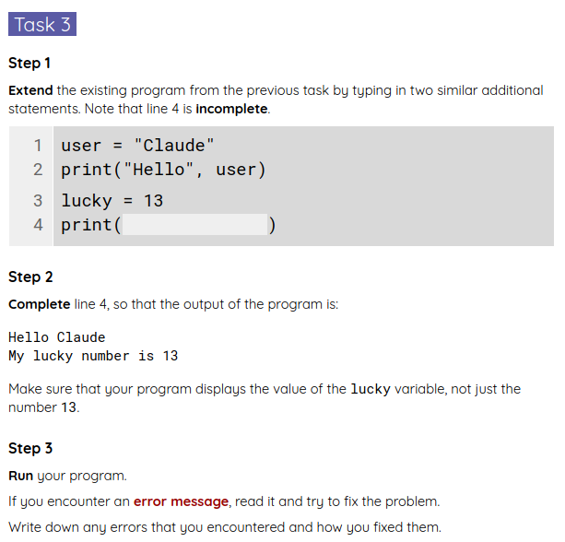
Activity 2
Your first steps in Python
Complete the third task in your worksheet.

Slide 22
Activity 2
Your first steps in Python: commentary
user = "Claude"
print("Hello", user)
lucky = 13
print("My lucky number is", lucky)
user is a variable.
It is assigned a string value.
lucky is another variable.
It is assigned an integer value.
It is useful to sketch variables and their corresponding values, as they change during program execution.
user
"Claude"
lucky
13

Slide 23
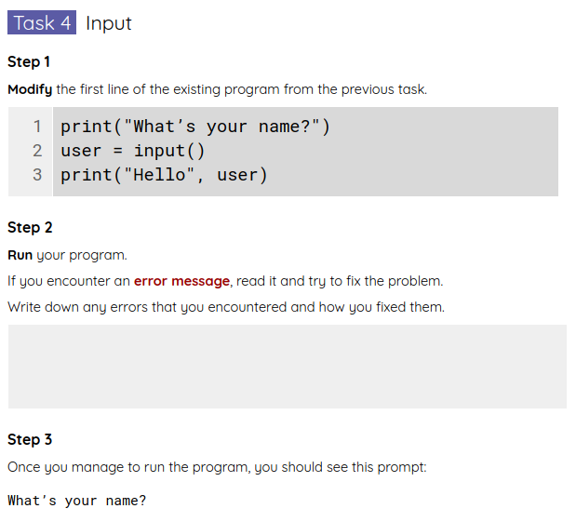
Activity 2
Your first steps in Python
Complete the final task in your worksheet, to make your program receive input from the user.

Slide 24
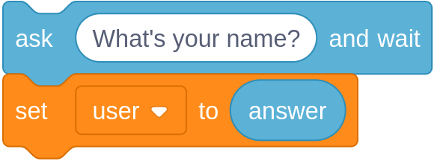
Activity 2
Your first steps in Python: commentary
print("What’s your name?")
user = input()
print("Hello", user)
You will need the input function:
when your program must receive keyboard input from the user.
When input is invoked, the program pauses, waiting for keyboard input.
The text typed by the user is assigned to the user variable.
We can refer to the value of user in the program without knowing what it will be.

Slide 25
Activity 3
Python recap
print("Best film ever?")
film = input()
print(film, "is my favourite too!")
Locate the fragment(s) of code that:
Display a message for the user on the screen
Retrieve what the user types on the keyboard
Assign a value to a variable

Slide 26
Summary
In this lesson, you...
Next lesson, you will...
Defined what algorithms and programs are
Wrote and executed your first Python programs (and weeded out syntax errors)
Your programs involved displaying messages, assigning values to variables, and receiving input from the keyboard
Use arithmetic expressions to calculate values
Trace the values of variables as a program is executed
Write programs that receive numerical input from the keyboard

